Slide 1
Mapping
Linked Art (linked.art)
to Schema.org
Craig Parry & Jon Sykora

Slide 2
Project Proposal
We gained inspiration for our project from the Georgia O'keeffe museum, which uses the Linked Art (linked.art) model to annotate their web data. Our project focused on building a mapping from Linked.art to Schema.org in an effort to help extend the reach of data that has implemented annotations with the Linked.art model.
To reach our goal we need to complete the following steps:
Research a current mapping of linked.art to schema.org
Describe and document a mapping of linked.art to schema.org (if necessary)
Build a demo to map a sample of semantically annotated data from Okeeffe Museum to schema.org annotations
Extend the demo to all labels categorized by linked.art that have a mapping in schema.org

Slide 3
Linked.art
Community project
Linked Open Usable Data (LOUD) principles
JSON-LD for usability with developers and ontological constructs built into the JSON structure

Slide 4
Linked.art
Community project
Linked Open Usable Data (LOUD) principles
Should be understandable, easy to use, and express schema without the need for users to fully understand ontologies and theoretical semantics
JSON-LD for usability with developers and ontological constructs built into the JSON structure

Slide 5
Linked.art
Community project
Linked Open Usable Data principles
JSON-LD for usability with developers and ontological constructs built into the JSON structure

Slide 6
Linked Art VisualItem JSON-LD example
<script type="application/ld+json"> { "@context": "https://linked.art/ns/v1/linked-art.json", "id": "https://linked.art/example/VisualItem/0", "type": "VisualItem", "_label": "Appearance of Miro's The Farm", "classified_as": [ { “id": "http://vocab.getty.edu/aat/300021495", "type": "Type", "_label": "Cubist", "classified_as": [ { “id": "http://vocab.getty.edu/aat/300015646", "type": "Type", "_label": "Style" } ] } ], "identified_by": [ { "type": "Name", "content": "Appearance of The Farm" } ], "referred_to_by": [ { "type": "LinguisticObject", "classified_as": [ { "id": "http://vocab.getty.edu/aat/300435416", "type": "Type", "_label": "Description", "classified_as": [ { "id": "http://vocab.getty.edu/aat/300418049", "type": "Type", "_label": "Brief Text" } ] } ], "content": "A brilliant amalgamation of an intense, even primitive, realism | with the formal vocabulary of cubism." } ], "represents_instance_of_type": [ { "id": "http://vocab.getty.edu/aat/300132410", "type": "Type", "_label": "Tree" } ], "shown_by": [ { "id": "https://www.nga.gov/collection/art-object-page.69660.html", "type": "HumanMadeObject", "_label": "The Farm" } ], "created_by": { "type": "Creation", "timespan": { "type": "TimeSpan", "_label": "1921-1922", "begin_of_the_begin": "1921-01-01T00:00:00Z", "end_of_the_end": "1922-12-31T23:59:59Z" }, "carried_out_by": [ { "id": "http://vocab.getty.edu/ulan/500014094", "type": "Person", "_label": "Juan Miro" } ] }, "represents": [ { "id": "http://vocab.getty.edu/tgn/7300934", "type": "Place", "_label": "Mont-roig del Camp" } ] }

Slide 7
Schema.org
Collaborative effort by Google, Microsoft and Yandex
Philosophy of the project is to annotate as much web data as possible
Hierarchical design where every type described is a child of “Thing”
Schema described with ontologies and theoretical semantic correctness

Slide 8
Schema.org
Collaborative effort by Google, Microsoft and Yandex
Philosophy of the project is to annotate as much web data as possible
Hierarchical design where every type described is a child of “Thing”
Schema described with ontologies and theoretical semantic correctness

Slide 9
Schema.org
Collaborative effort by Google, Microsoft and Yandex
Philosophy of the project is to annotate as much web data as possible
Hierarchical design
Every type described is a child of “Thing”
Schema described with ontologies and theoretical semantic correctness

Slide 10
Schema.org
Collaborative effort by Google, Microsoft and Yandex
Philosophy of the project is to annotate as much web data as possible
Hierarchical design where every type described is a child of “Thing”
Schema described with ontologies and theoretical semantic correctness

Slide 11
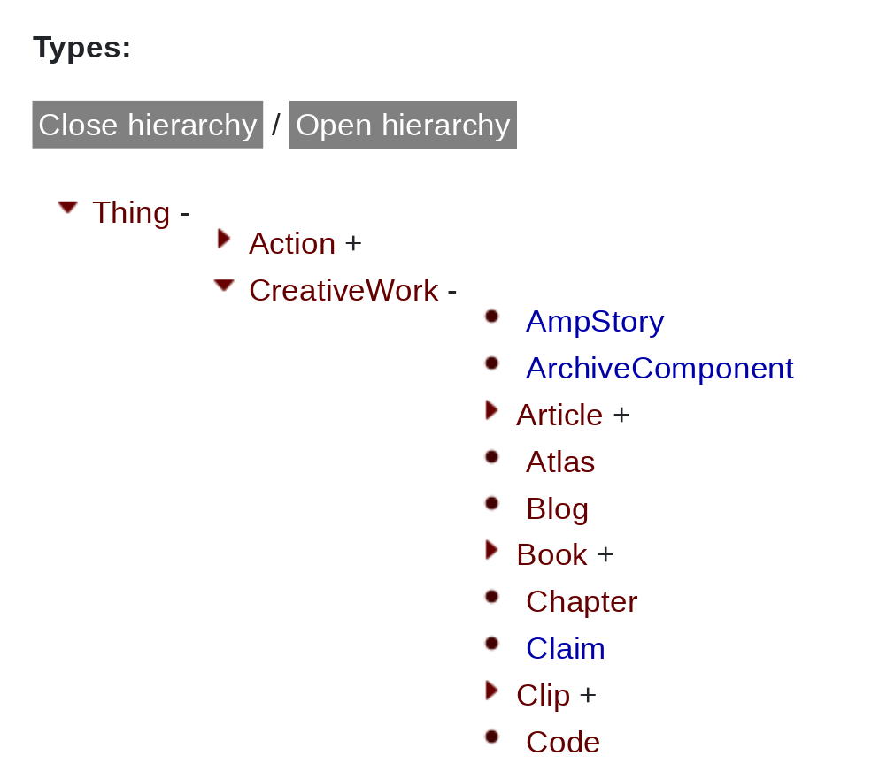

....

Slide 12
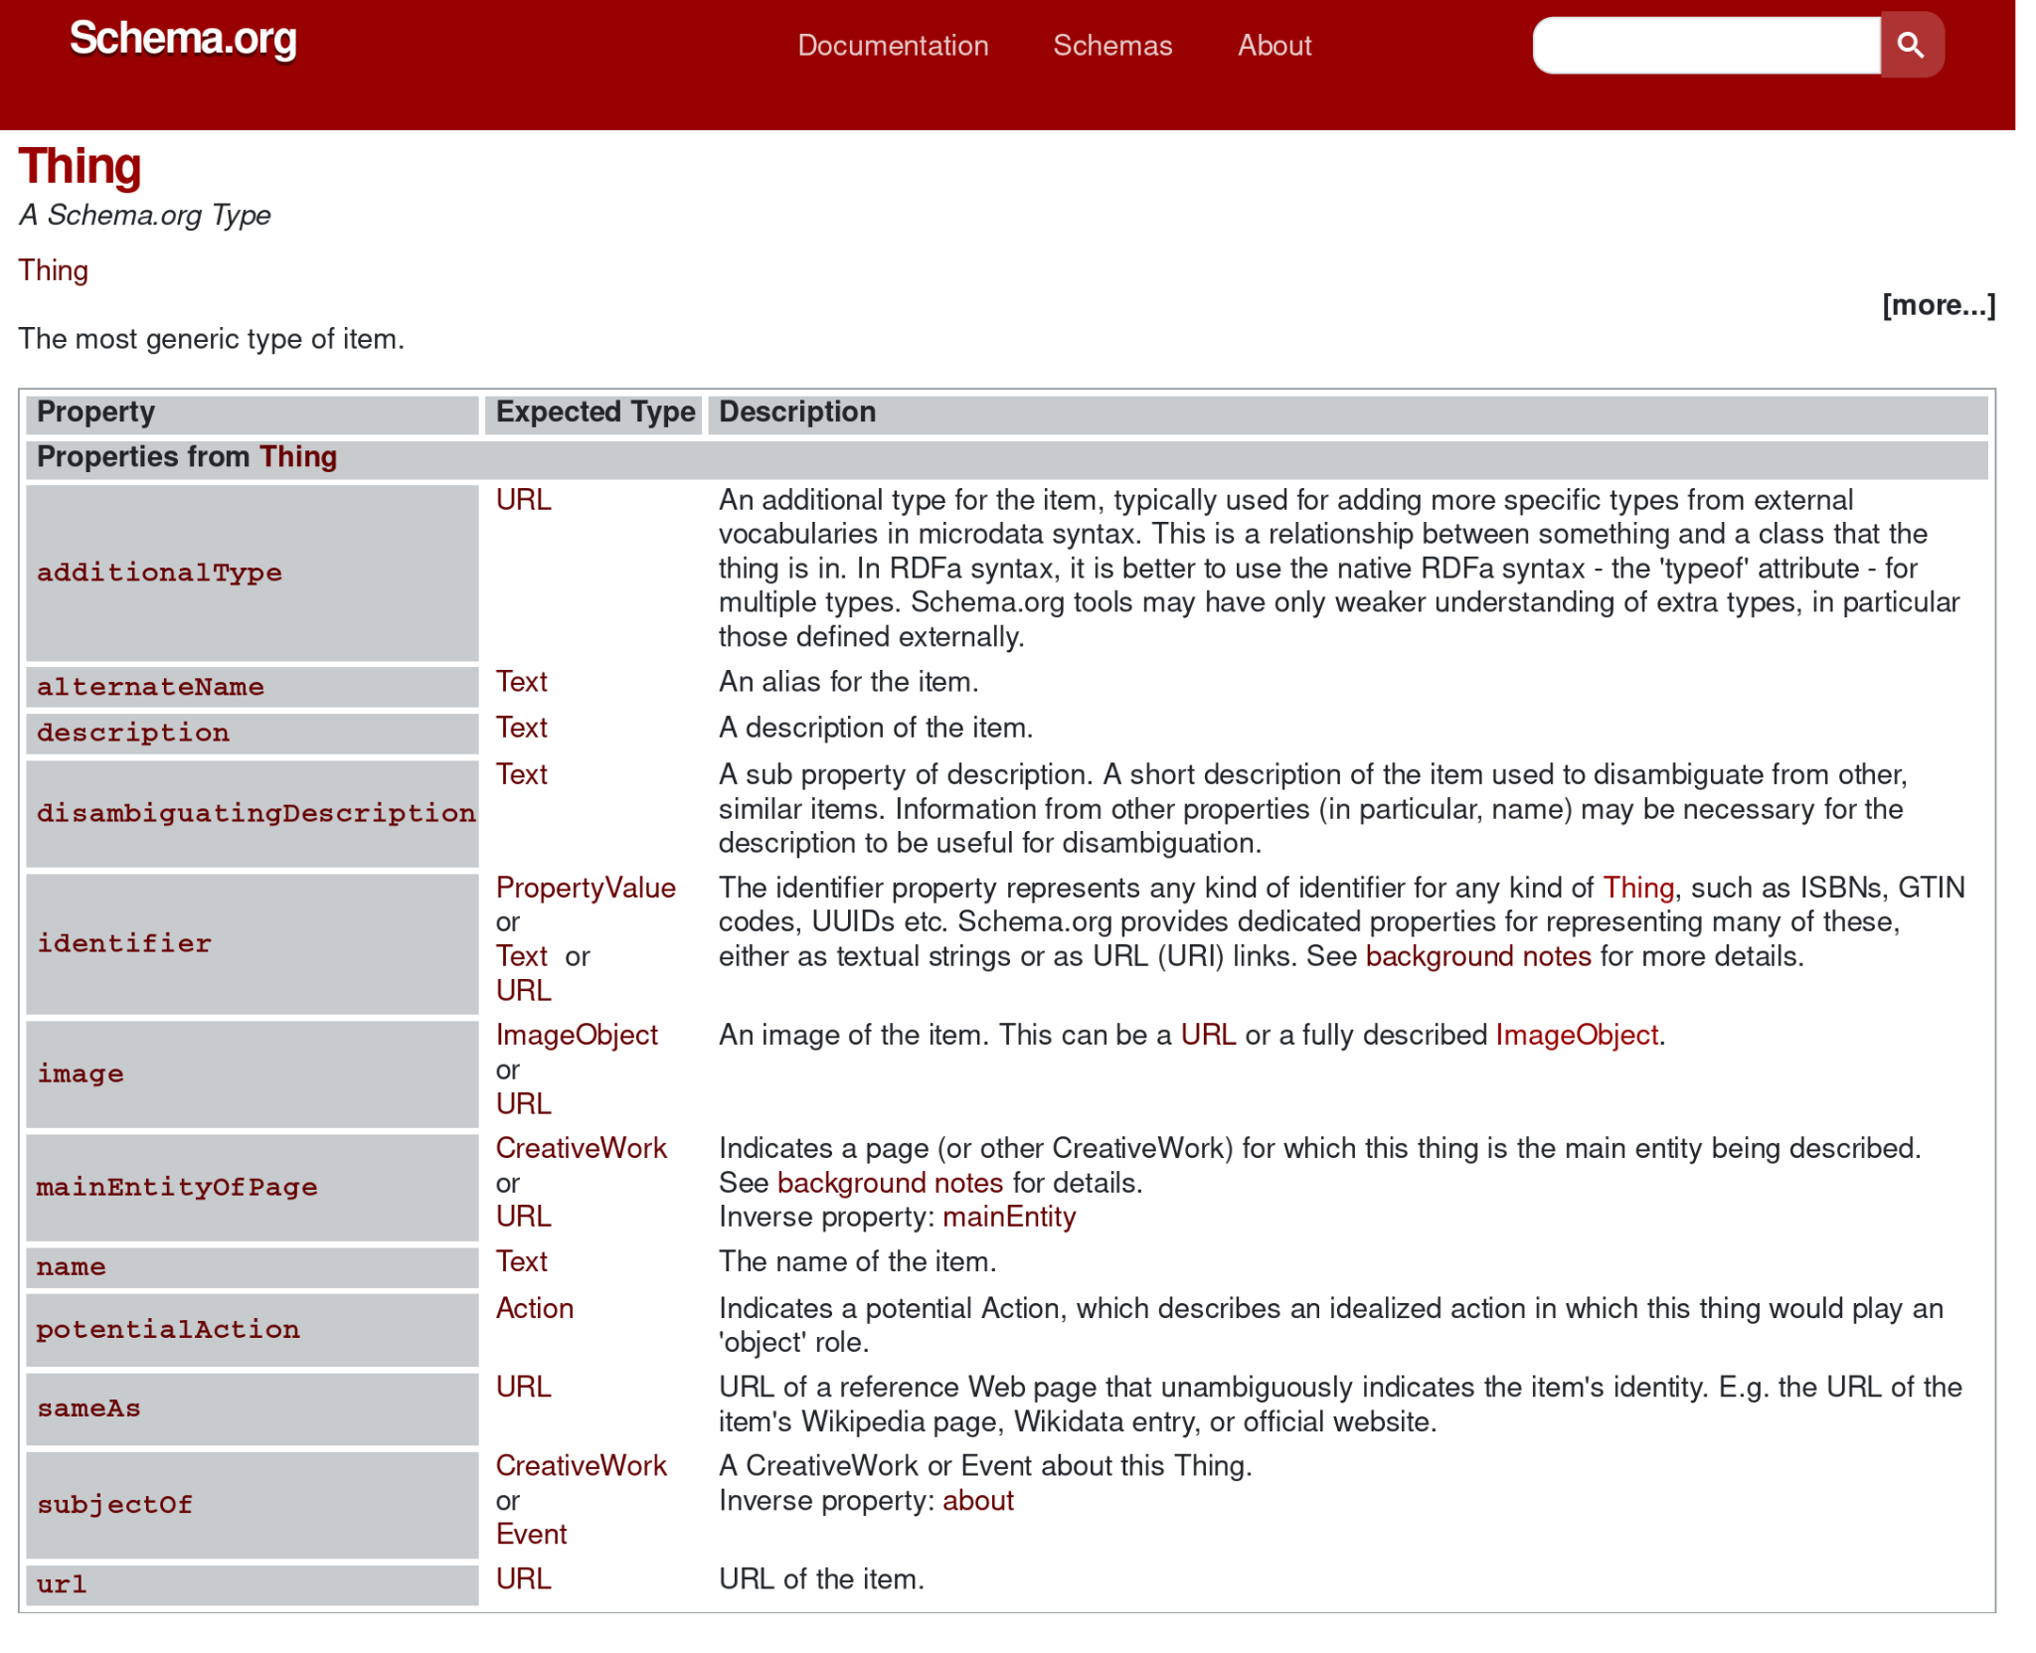

Slide 13
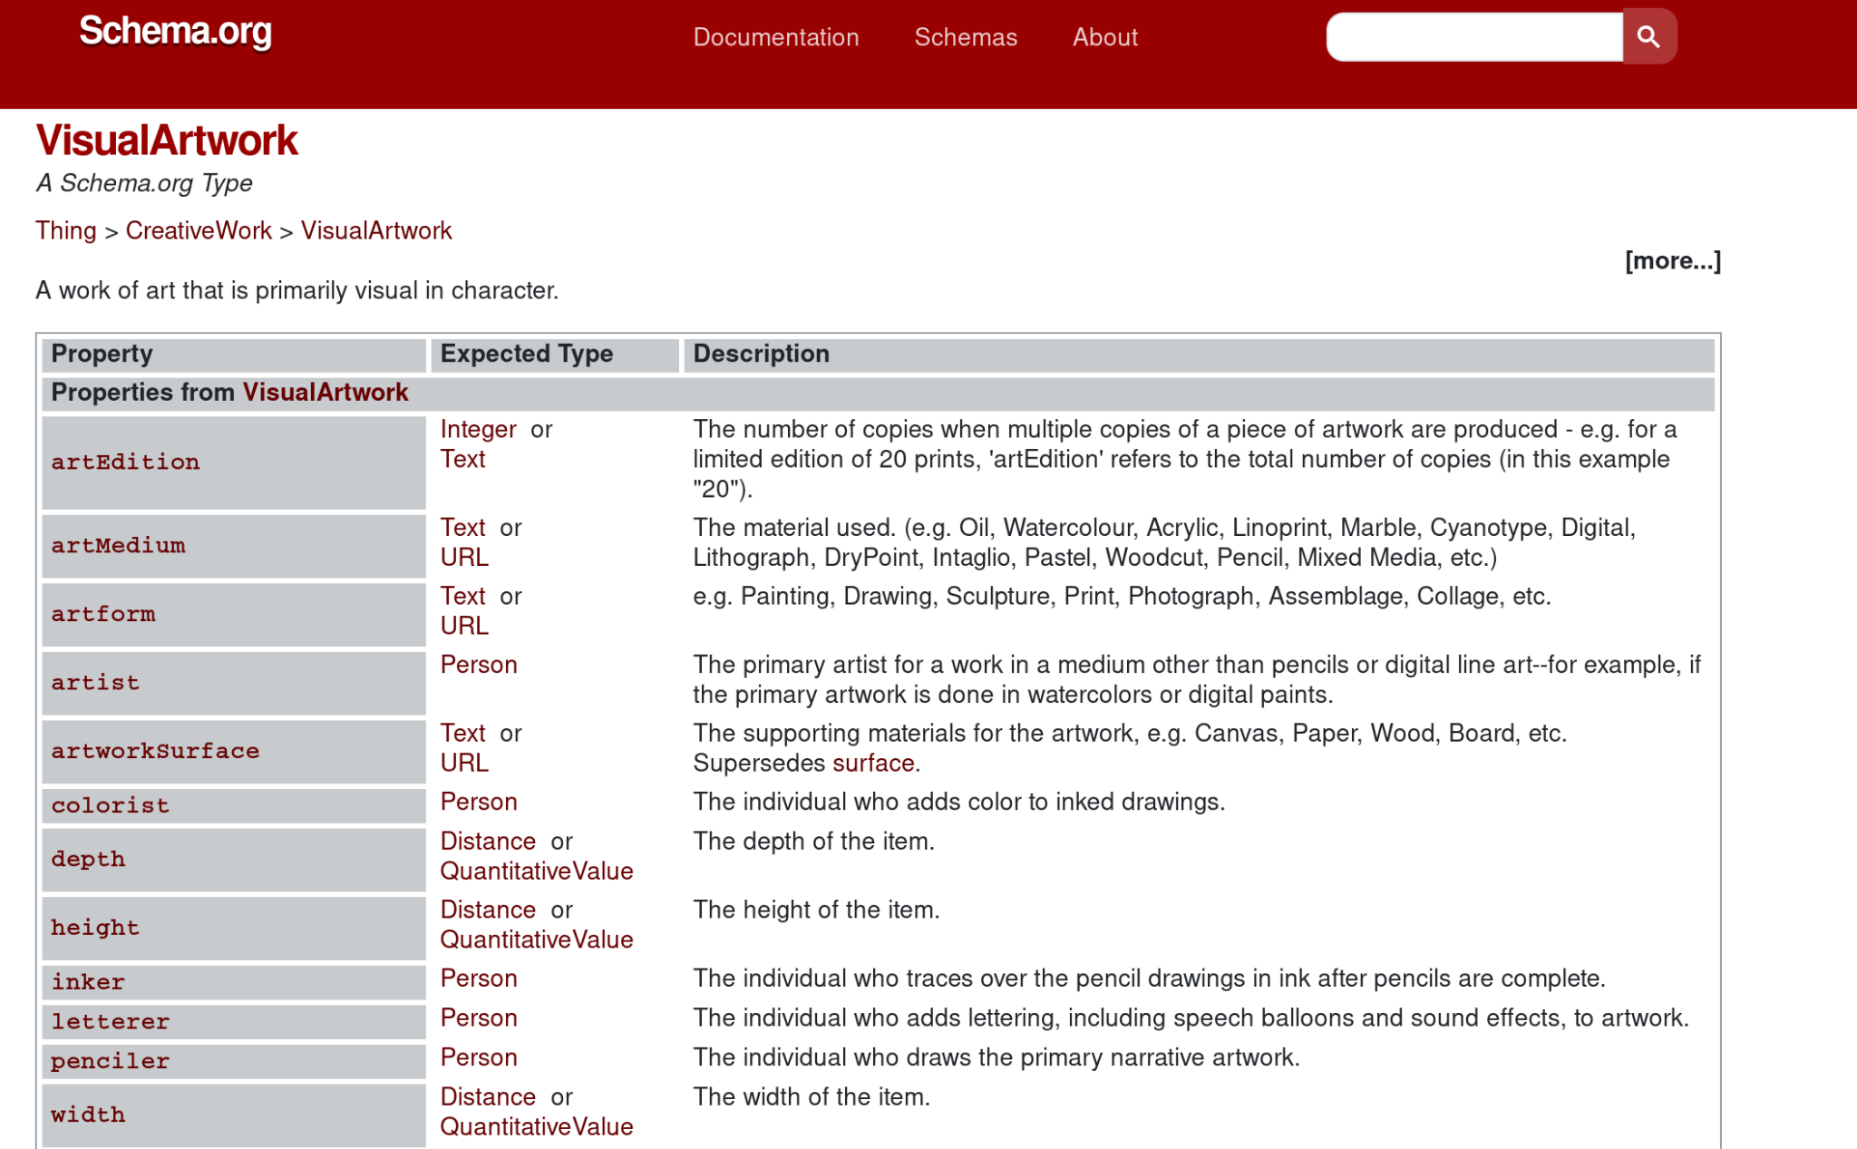

Slide 14
Mapping
Example of Linked Art’s VisualItem mapped to Schema.org’s VisualArtwork
Example of Linked Art’s HumanMadeObject mapped to Schema.org’s VisualArtwork
Discuss Linked Art’s VisualItem and HumanMadeObject’s unique and redundant properties and data

Slide 15
Linked Art VisualItem JSON-LD example
<script type="application/ld+json"> { "@context": "https://linked.art/ns/v1/linked-art.json", "id": "https://linked.art/example/VisualItem/0", "type": "VisualItem", "_label": "Appearance of Miro's The Farm", "classified_as": [ { “id": "http://vocab.getty.edu/aat/300021495", "type": "Type", "_label": "Cubist", "classified_as": [ { “id": "http://vocab.getty.edu/aat/300015646", "type": "Type", "_label": "Style" } ] } ], "identified_by": [ { "type": "Name", "content": "Appearance of The Farm" } ], "referred_to_by": [ { "type": "LinguisticObject", "classified_as": [ { "id": "http://vocab.getty.edu/aat/300435416", "type": "Type", "_label": "Description", "classified_as": [ { "id": "http://vocab.getty.edu/aat/300418049", "type": "Type", "_label": "Brief Text" } ] } ], "content": "A brilliant amalgamation of an intense, even primitive, realism | with the formal vocabulary of cubism." } ], "represents_instance_of_type": [ { "id": "http://vocab.getty.edu/aat/300132410", "type": "Type", "_label": "Tree" } ], "shown_by": [ { "id": "https://www.nga.gov/collection/art-object-page.69660.html", "type": "HumanMadeObject", "_label": "The Farm" } ], "created_by": { "type": "Creation", "timespan": { "type": "TimeSpan", "_label": "1921-1922", "begin_of_the_begin": "1921-01-01T00:00:00Z", "end_of_the_end": "1922-12-31T23:59:59Z" }, "carried_out_by": [ { "id": "http://vocab.getty.edu/ulan/500014094", "type": "Person", "_label": "Juan Miro" } ] }, "represents": [ { "id": "http://vocab.getty.edu/tgn/7300934", "type": "Place", "_label": "Mont-roig del Camp" } ] }

Slide 16
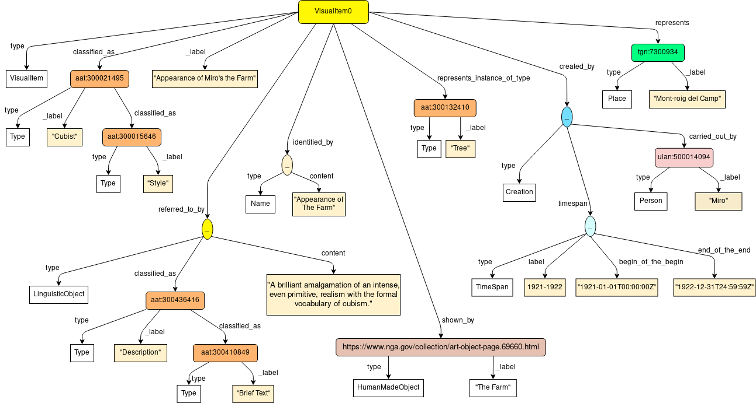

Slide 17
Linked Art VisualItem JSON-LD example
<script type="application/ld+json"> { "@context": "https://linked.art/ns/v1/linked-art.json", "id": "https://linked.art/example/VisualItem/0", "type": "VisualItem", "_label": "Appearance of Miro's The Farm", "classified_as": [ { “id": "http://vocab.getty.edu/aat/300021495", "type": "Type", "_label": "Cubist", "classified_as": [ { “id": "http://vocab.getty.edu/aat/300015646", "type": "Type", "_label": "Style" } ] } ], "identified_by": [ { "type": "Name", "content": "Appearance of The Farm" } ], "referred_to_by": [ { "type": "LinguisticObject", "classified_as": [ { "id": "http://vocab.getty.edu/aat/300435416", "type": "Type", "_label": "Description", "classified_as": [ { "id": "http://vocab.getty.edu/aat/300418049", "type": "Type", "_label": "Brief Text" } ] } ], "content": "A brilliant amalgamation of an intense, even primitive, realism | with the formal vocabulary of cubism." } ], "represents_instance_of_type": [ { "id": "http://vocab.getty.edu/aat/300132410", "type": "Type", "_label": "Tree" } ], "shown_by": [ { "id": "https://www.nga.gov/collection/art-object-page.69660.html", "type": "HumanMadeObject", "_label": "The Farm" } ], "created_by": { "type": "Creation", "timespan": { "type": "TimeSpan", "_label": "1921-1922", "begin_of_the_begin": "1921-01-01T00:00:00Z", "end_of_the_end": "1922-12-31T23:59:59Z" }, "carried_out_by": [ { "id": "http://vocab.getty.edu/ulan/500014094", "type": "Person", "_label": "Juan Miro" } ] }, "represents": [ { "id": "http://vocab.getty.edu/tgn/7300934", "type": "Place", "_label": "Mont-roig del Camp" } ] }

Slide 19
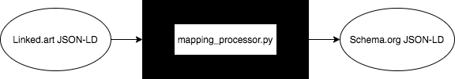
Mapping Processor tool
A command line tool was developed using Python that can take a VisualItem or HumanMadeObject Linked Art JSON-LD file, and produce a VisualArtwork Schema.org JSON-LD file. The following slide contains the content of the Linked.art VisualItem JSON-LD example, and the corresponding mapped file produced.

Slide 20
Linked.art VisualItem JSON-LD example | Schema.org mapped JSON-LD example
<script type="application/ld+json"> { "@context": "https://linked.art/ns/v1/linked-art.json", "id": "https://linked.art/example/VisualItem/0", "type": "VisualItem", "_label": "Appearance of Miro's The Farm", "classified_as": [ { “id": "http://vocab.getty.edu/aat/300021495", "type": "Type", "_label": "Cubist", "classified_as": [ { “id": "http://vocab.getty.edu/aat/300015646", "type": "Type", "_label": "Style" } ] } ], "identified_by": [ { "type": "Name", "content": "Appearance of The Farm" } ], "referred_to_by": [ { "type": "LinguisticObject", "classified_as": [ { "id": "http://vocab.getty.edu/aat/300435416", "type": "Type", "_label": "Description", "classified_as": [ { "id": "http://vocab.getty.edu/aat/300418049", "type": "Type", "_label": "Brief Text" } ] } ], "content": "A brilliant amalgamation of an intense, even primitive, realism with the formal vocabulary of cubism." | <script type="application/ld+json"> { "@context": "https://schema.org", "@type": "VisualArtwork", “name”: “The Farm”, “alternateName”: “Appearance of the Farm”, “mainEntity”: “Tree”, “dateCreated": "1922", “contentLocation”: “Mont-roig del Camp”, “url”: “https://www.nga.gov/collection/art-object-page.69660.html” "description": "A brilliant amalgamation of an intense, even primitive, realism with the formal vocabulary of cubism.", "creator": [ { "@type": "Person", "name": "Juan Miro" } ] }

Slide 21
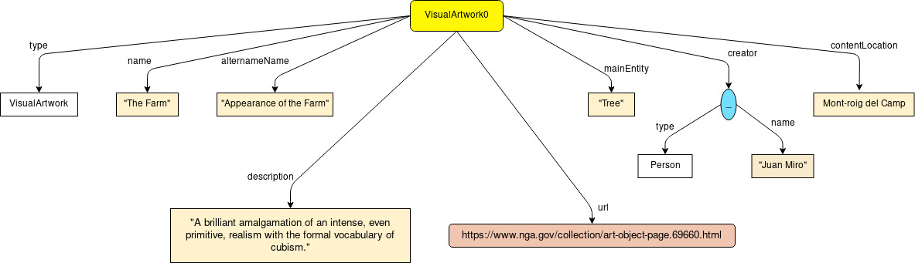
Schema.org VisualArtwork Mapped Property Diagram

Slide 22
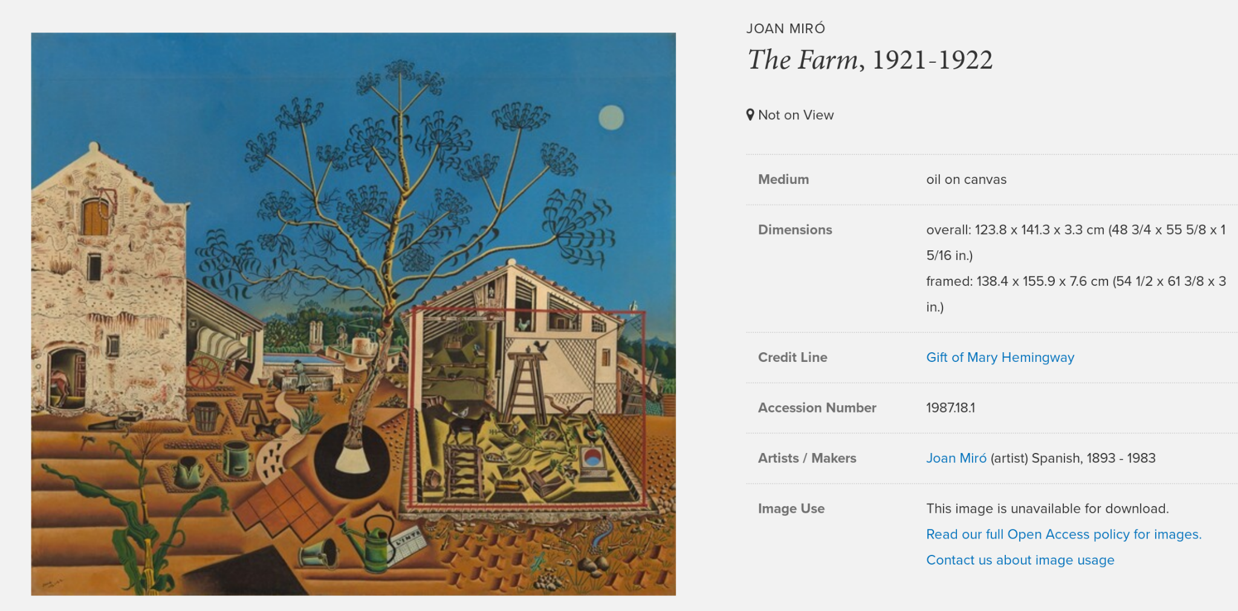

Slide 23
Linked.art VisualItem JSON-LD example | Schema.org mapped JSON-LD example
<script type="application/ld+json"> { "@context": "https://linked.art/ns/v1/linked-art.json", "id": "https://linked.art/example/VisualItem/0", "type": "VisualItem", "_label": "Appearance of Miro's The Farm", "classified_as": [ { “id": "http://vocab.getty.edu/aat/300021495", "type": "Type", "_label": "Cubist", "classified_as": [ { “id": "http://vocab.getty.edu/aat/300015646", "type": "Type", "_label": "Style" } ] } ], "identified_by": [ { "type": "Name", "content": "Appearance of The Farm" } ], "referred_to_by": [ { "type": "LinguisticObject", "classified_as": [ { "id": "http://vocab.getty.edu/aat/300435416", "type": "Type", "_label": "Description", "classified_as": [ { "id": "http://vocab.getty.edu/aat/300418049", "type": "Type", "_label": "Brief Text" } ] } ], "content": "A brilliant amalgamation of an intense, even primitive, realism with the formal vocabulary of cubism." | <script type="application/ld+json"> { "@context": "https://schema.org", "@type": "VisualArtwork", "name": "The Farm", "alternateName": "Appearance of The Farm", "creator": [ { "@type": "Person", "name": "Juan Miro" } ], "dateCreated": "1922", "mainEntity": "Tree", "contentLocation": "Mont-roig del Camp", "url": "https://www.nga.gov/collection/art-object-page.69660.html", "description": "A brilliant amalgamation of an intense, even primitive, realism with the formal vocabulary of cubism." }
Not
Mapped

Slide 24
Linked.art VisualItem JSON-LD example | Schema.org mapped JSON-LD example
<script type="application/ld+json"> { "@context": "https://linked.art/ns/v1/linked-art.json", "id": "https://linked.art/example/VisualItem/0", "type": "VisualItem", "_label": "Appearance of Miro's The Farm", "classified_as": [ { “id": "http://vocab.getty.edu/aat/300021495", "type": "Type", "_label": "Cubist", "classified_as": [ { “id": "http://vocab.getty.edu/aat/300015646", "type": "Type", "_label": "Style" } ] } ], "identified_by": [ { "type": "Name", "content": "Appearance of The Farm" } ], "referred_to_by": [ { "type": "LinguisticObject", "classified_as": [ { "id": "http://vocab.getty.edu/aat/300435416", "type": "Type", "_label": "Description", "classified_as": [ { "id": "http://vocab.getty.edu/aat/300418049", "type": "Type", "_label": "Brief Text" } ] } ], "content": "A brilliant amalgamation of an intense, even primitive, realism with the formal vocabulary of cubism." | <script type="application/ld+json"> { "@context": "https://schema.org", "@type": "VisualArtwork", "name": "The Farm", "alternateName": "Appearance of The Farm", "creator": [ { "@type": "Person", "name": "Juan Miro" } ], "dateCreated": "1922", "mainEntity": "Tree", "contentLocation": "Mont-roig del Camp", "url": "https://www.nga.gov/collection/art-object-page.69660.html", "description": "A brilliant amalgamation of an intense, even primitive, realism with the formal vocabulary of cubism." }

Slide 25
Linked.art VisualItem JSON-LD example | Schema.org mapped JSON-LD example
<script type="application/ld+json"> { "@context": "https://linked.art/ns/v1/linked-art.json", "id": "https://linked.art/example/VisualItem/0", "type": "VisualItem", "_label": "Appearance of Miro's The Farm", "classified_as": [ { “id": "http://vocab.getty.edu/aat/300021495", "type": "Type", "_label": "Cubist", "classified_as": [ { “id": "http://vocab.getty.edu/aat/300015646", "type": "Type", "_label": "Style" } ] } ], "identified_by": [ { "type": "Name", "content": "Appearance of The Farm" } ], "referred_to_by": [ { "type": "LinguisticObject", "classified_as": [ { "id": "http://vocab.getty.edu/aat/300435416", "type": "Type", "_label": "Description", "classified_as": [ { "id": "http://vocab.getty.edu/aat/300418049", "type": "Type", "_label": "Brief Text" } ] } ], "content": "A brilliant amalgamation of an intense, even primitive, realism with the formal vocabulary of cubism." | <script type="application/ld+json"> { "@context": "https://schema.org", "@type": "VisualArtwork", "name": "The Farm", "alternateName": "Appearance of The Farm", "creator": [ { "@type": "Person", "name": "Juan Miro" } ], "dateCreated": "1922", "mainEntity": "Tree", "contentLocation": "Mont-roig del Camp", "url": "https://www.nga.gov/collection/art-object-page.69660.html", "description": "A brilliant amalgamation of an intense, even primitive, realism with the formal vocabulary of cubism." }

Slide 26
Linked.art VisualItem JSON-LD example | Schema.org mapped JSON-LD example
} ], "represents_instance_of_type": [ { "id": "http://vocab.getty.edu/aat/300132410", "type": "Type", "_label": "Tree" } ], "shown_by": [ { "id": "https://www.nga.gov/collection/art-object-page.69660.html", "type": "HumanMadeObject", "_label": "The Farm" } ], "created_by": { "type": "Creation", "timespan": { "type": "TimeSpan", "_label": "1921-1922", "begin_of_the_begin": "1921-01-01T00:00:00Z", "end_of_the_end": "1922-12-31T23:59:59Z" }, "carried_out_by": [ { "id": "http://vocab.getty.edu/ulan/500014094", "type": "Person", "_label": "Juan Miro" } ] }, "represents": [ { "id": "http://vocab.getty.edu/tgn/7300934", "type": "Place", "_label": "Mont-roig del Camp" } ] } | <script type="application/ld+json"> { "@context": "https://schema.org", "@type": "VisualArtwork", "name": "The Farm", "alternateName": "Appearance of The Farm", "creator": [ { "@type": "Person", "name": "Juan Miro" } ], "dateCreated": "1922", "mainEntity": "Tree", "contentLocation": "Mont-roig del Camp", "url": "https://www.nga.gov/collection/art-object-page.69660.html", "description": "A brilliant amalgamation of an intense, even primitive, realism with the formal vocabulary of cubism." }

Slide 27
Linked.art VisualItem JSON-LD example | Schema.org mapped JSON-LD example
} ], "represents_instance_of_type": [ { "id": "http://vocab.getty.edu/aat/300132410", "type": "Type", "_label": "Tree" } ], "shown_by": [ { "id": "https://www.nga.gov/collection/art-object-page.69660.html", "type": "HumanMadeObject", "_label": "The Farm" } ], "created_by": { "type": "Creation", "timespan": { "type": "TimeSpan", "_label": "1921-1922", "begin_of_the_begin": "1921-01-01T00:00:00Z", "end_of_the_end": "1922-12-31T23:59:59Z" }, "carried_out_by": [ { "id": "http://vocab.getty.edu/ulan/500014094", "type": "Person", "_label": "Juan Miro" } ] }, "represents": [ { "id": "http://vocab.getty.edu/tgn/7300934", "type": "Place", "_label": "Mont-roig del Camp" } ] } | <script type="application/ld+json"> { "@context": "https://schema.org", "@type": "VisualArtwork", "name": "The Farm", "alternateName": "Appearance of The Farm", "creator": [ { "@type": "Person", "name": "Juan Miro" } ], "dateCreated": "1922", "mainEntity": "Tree", "contentLocation": "Mont-roig del Camp", "url": "https://www.nga.gov/collection/art-object-page.69660.html", "description": "A brilliant amalgamation of an intense, even primitive, realism with the formal vocabulary of cubism." }

Slide 28
Linked.art VisualItem JSON-LD example | Schema.org mapped JSON-LD example
} ], "represents_instance_of_type": [ { "id": "http://vocab.getty.edu/aat/300132410", "type": "Type", "_label": "Tree" } ], "shown_by": [ { "id": "https://www.nga.gov/collection/art-object-page.69660.html", "type": "HumanMadeObject", "_label": "The Farm" } ], "created_by": { "type": "Creation", "timespan": { "type": "TimeSpan", "_label": "1921-1922", "begin_of_the_begin": "1921-01-01T00:00:00Z", "end_of_the_end": "1922-12-31T23:59:59Z" }, "carried_out_by": [ { "id": "http://vocab.getty.edu/ulan/500014094", "type": "Person", "_label": "Juan Miro" } ] }, "represents": [ { "id": "http://vocab.getty.edu/tgn/7300934", "type": "Place", "_label": "Mont-roig del Camp" } ] } | <script type="application/ld+json"> { "@context": "https://schema.org", "@type": "VisualArtwork", "name": "The Farm", "alternateName": "Appearance of The Farm", "creator": [ { "@type": "Person", "name": "Juan Miro" } ], "dateCreated": "1922", "mainEntity": "Tree", "contentLocation": "Mont-roig del Camp", "url": "https://www.nga.gov/collection/art-object-page.69660.html", "description": "A brilliant amalgamation of an intense, even primitive, realism with the formal vocabulary of cubism." }

Slide 30
Linked.art VisualItem JSON-LD example | Schema.org mapped JSON-LD example
} ], "represents_instance_of_type": [ { "id": "http://vocab.getty.edu/aat/300132410", "type": "Type", "_label": "Tree" } ], "shown_by": [ { "id": "https://www.nga.gov/collection/art-object-page.69660.html", "type": "HumanMadeObject", "_label": "The Farm" } ], "created_by": { "type": "Creation", "timespan": { "type": "TimeSpan", "_label": "1921-1922", "begin_of_the_begin": "1921-01-01T00:00:00Z", "end_of_the_end": "1922-12-31T23:59:59Z" }, "carried_out_by": [ { "id": "http://vocab.getty.edu/ulan/500014094", "type": "Person", "_label": "Juan Miro" } ] }, "represents": [ { "id": "http://vocab.getty.edu/tgn/7300934", "type": "Place", "_label": "Mont-roig del Camp" } ] } | <script type="application/ld+json"> { "@context": "https://schema.org", "@type": "VisualArtwork", "name": "The Farm", "alternateName": "Appearance of The Farm", "creator": [ { "@type": "Person", "name": "Juan Miro" } ], "dateCreated": "1922", "mainEntity": "Tree", "contentLocation": "Mont-roig del Camp", "url": "https://www.nga.gov/collection/art-object-page.69660.html", "description": "A brilliant amalgamation of an intense, even primitive, realism with the formal vocabulary of cubism." }

Slide 31
Linked.art HumanMadeObject JSON-LD example
<script type="application/ld+json"> { "@context": "https://linked.art/ns/v1/linked-art.json", "id": "https://linked.art/example/object/0", "type": "HumanMadeObject", "_label": "The Farm", "classified_as": [ { "id": "http://vocab.getty.edu/aat/300033618", "type": "Type", "_label": "Painting", "classified_as": [ { "id": "http://vocab.getty.edu/aat/300435443", "type": "Type", "_label": "Type of Work" } ] }, { "id": "http://vocab.getty.edu/aat/300133025", "type": "Type", "_label": "Artwork" } ], "identified_by": [ { "type": "Name", "classified_as": [ { "id": "http://vocab.getty.edu/aat/300404670", "type": "Type", "_label": "Primary Name" } ], "content": "The Farm", "language": [ { "id": "http://vocab.getty.edu/aat/300388277", "type": "Language", "_label": "English" } ] }, { | "type": "Identifier", "classified_as": [ { "id": "http://vocab.getty.edu/aat/300312355", "type": "Type", "_label": "Accession Number" } ], "content": "1987.18.1" } ], "referred_to_by": [ { "type": "LinguisticObject", “classified_as": [ { "id": "http://vocab.getty.edu/aat/300435416", "type": "Type", "_label": "Description", "classified_as": [ { "id": "http://vocab.getty.edu/aat/300418049", "type": "Type", "_label": "Brief Text" } ] } ], "content": "A brilliant amalgamation of an intense, even primitive, realism with the formal vocabulary of cubism." } ], "dimension": [ { "type": "Dimension", "classified_as": [ { "id": "http://vocab.getty.edu/aat/300055644", "type": "Type", "_label": "Height" } ], "value": 123.8, "unit": { "id": "http://vocab.getty.edu/aat/300379098",
Not Mapped

Slide 32
Linked.art HumanMadeObject JSON-LD example
"type": "MeasurementUnit", "_label": "centimeters" } }, { "type": "Dimension", "classified_as": [ { "id": "http://vocab.getty.edu/aat/300055647", "type": "Type", "_label": "Width" } ], "value": 141.3, "unit": { "id": "http://vocab.getty.edu/aat/300379098", "type": "MeasurementUnit", "_label": "centimeters" } } ], "made_of": [ { "id": "http://vocab.getty.edu/aat/300012363", “type": "Material", "_label": "Canvas" }, { "id": "http://vocab.getty.edu/aat/300015050", "type": "Material", "_label": "Oil Paint" } ], "shows": [ { "id": "https://www.nga.gov/collection/art-object-page.69660.html", “type": "VisualItem", "_label": "Appearance of the Farm" } ], "current_owner": [ { "id": "https://www.nga.gov/", “type": "Group", "_label": "National Gallery of Art" | } ], "equivalent": [ { "id": "https://www.wikidata.org/wiki/Q1192436", “type": "HumanMadeObject", "_label": "The Farm" } ], "produced_by": { "type": "Production", "timespan": { "type": "TimeSpan", "identified_by": [ { "type": "Name", "classified_as": [ { "id": "http://vocab.getty.edu/aat/300404669", "type": "Type", "_label": "Display Title" } ], "content": "1921-1922" } ], "begin_of_the_begin": "1921-01-01T00:00:00Z", "end_of_the_end": "1922-12-31T23:59:59Z" }, "took_place_at": [ { "id": "http://vocab.getty.edu/tgn/7000457", "type": "Place", "_label": "Mont-roig del Camp, Spain" } ], "carried_out_by": [ { "id": "http://vocab.getty.edu/ulan/500010879", "type": "Person", "_label": "Juan Miro" } ] } }
Not Mapped

Slide 33
Linked.art HumanMadeObject JSON-LD example | Mapped Linked.art HumanMadeObject JSON-LD example
<script type="application/ld+json"> { "@context": "https://linked.art/ns/v1/linked-art.json", "id": "https://linked.art/example/object/0", "type": "HumanMadeObject", "_label": "The Farm", "classified_as": [ { "id": "http://vocab.getty.edu/aat/300033618", "type": "Type", "_label": "Painting", "classified_as": [ { "id": "http://vocab.getty.edu/aat/300435443", "type": "Type", "_label": "Type of Work" } ] }, { "id": "http://vocab.getty.edu/aat/300133025", "type": "Type", "_label": "Artwork" } ], "identified_by": [ { "type": "Name", "classified_as": [ { "id": "http://vocab.getty.edu/aat/300404670", "type": "Type", "_label": "Primary Name" } ], "content": "The Farm", "language": [ { "id": "http://vocab.getty.edu/aat/300388277", "type": "Language", "_label": "English" } ] }, { | <script type="application/ld+json"> { "@context": "https://schema.org", "@type": "VisualArtwork", "name": "The Farm", "alternateName": "Appearance of the Farm", "artForm": "Painting", "creator": [ { "@type": "Person", "name": "Juan Miro" } ], "dateCreated": "1922", "locationCreated": "Mont-roig del Camp, Spain", "sameAs": "https://www.wikidata.org/wiki/Q1192436", "url": "https://www.nga.gov/collection/art-object-page.69660.html", "description": "A brilliant amalgamation of an intense, even primitive, realism with the formal vocabulary of cubism.", "height": "123.8 centimeters", "width": "141.3 centimeters", "artworkSurface": "Canvas", "artMedium": "Oil Paint" }

Slide 34
Linked.art HumanMadeObject JSON-LD example | Mapped Linked.art HumanMadeObject JSON-LD example
"type": "MeasurementUnit", "_label": "centimeters" } }, { "type": "Dimension", "classified_as": [ { "id": "http://vocab.getty.edu/aat/300055647", "type": "Type", "_label": "Width" } ], "value": 141.3, "unit": { "id": "http://vocab.getty.edu/aat/300379098", "type": "MeasurementUnit", "_label": "centimeters" } } ], "made_of": [ { "id": "http://vocab.getty.edu/aat/300012363", “type": "Material", "_label": "Canvas" }, { "id": "http://vocab.getty.edu/aat/300015050", "type": "Material", "_label": "Oil Paint" } ], "shows": [ { "id": "https://www.nga.gov/collection/art-object-page.69660.html", “type": "VisualItem", "_label": "Appearance of the Farm" } ], "current_owner": [ { "id": "https://www.nga.gov/", “type": "Group", "_label": "National Gallery of Art" | <script type="application/ld+json"> { "@context": "https://schema.org", "@type": "VisualArtwork", "name": "The Farm", "alternateName": "Appearance of the Farm", "artForm": "Painting", "creator": [ { "@type": "Person", "name": "Juan Miro" } ], "dateCreated": "1922", "locationCreated": "Mont-roig del Camp, Spain", "sameAs": "https://www.wikidata.org/wiki/Q1192436", "url": "https://www.nga.gov/collection/art-object-page.69660.html", "description": "A brilliant amalgamation of an intense, even primitive, realism with the formal vocabulary of cubism.", "height": "123.8 centimeters", "width": "141.3 centimeters", "artworkSurface": "Canvas", "artMedium": "Oil Paint" }

Slide 35
Linked.art HumanMadeObject JSON-LD example | Mapped Linked.art HumanMadeObject JSON-LD example
} ], "equivalent": [ { "id": "https://www.wikidata.org/wiki/Q1192436", “type": "HumanMadeObject", "_label": "The Farm" } ], "produced_by": { "type": "Production", "timespan": { "type": "TimeSpan", "identified_by": [ { "type": "Name", "classified_as": [ { "id": "http://vocab.getty.edu/aat/300404669", "type": "Type", "_label": "Display Title" } ], "content": "1921-1922" } ], "begin_of_the_begin": "1921-01-01T00:00:00Z", "end_of_the_end": "1922-12-31T23:59:59Z" }, "took_place_at": [ { "id": "http://vocab.getty.edu/tgn/7000457", "type": "Place", "_label": "Mont-roig del Camp, Spain" } ], "carried_out_by": [ { "id": "http://vocab.getty.edu/ulan/500010879", "type": "Person", "_label": "Juan Miro" } ] } } | <script type="application/ld+json"> { "@context": "https://schema.org", "@type": "VisualArtwork", "name": "The Farm", "alternateName": "Appearance of the Farm", "artForm": "Painting", "creator": [ { "@type": "Person", "name": "Juan Miro" } ], "dateCreated": "1922", "locationCreated": "Mont-roig del Camp, Spain", "sameAs": "https://www.wikidata.org/wiki/Q1192436", "url": "https://www.nga.gov/collection/art-object-page.69660.html", "description": "A brilliant amalgamation of an intense, even primitive, realism with the formal vocabulary of cubism.", "height": "123.8 centimeters", "width": "141.3 centimeters", "artworkSurface": "Canvas", "artMedium": "Oil Paint" }

Slide 36
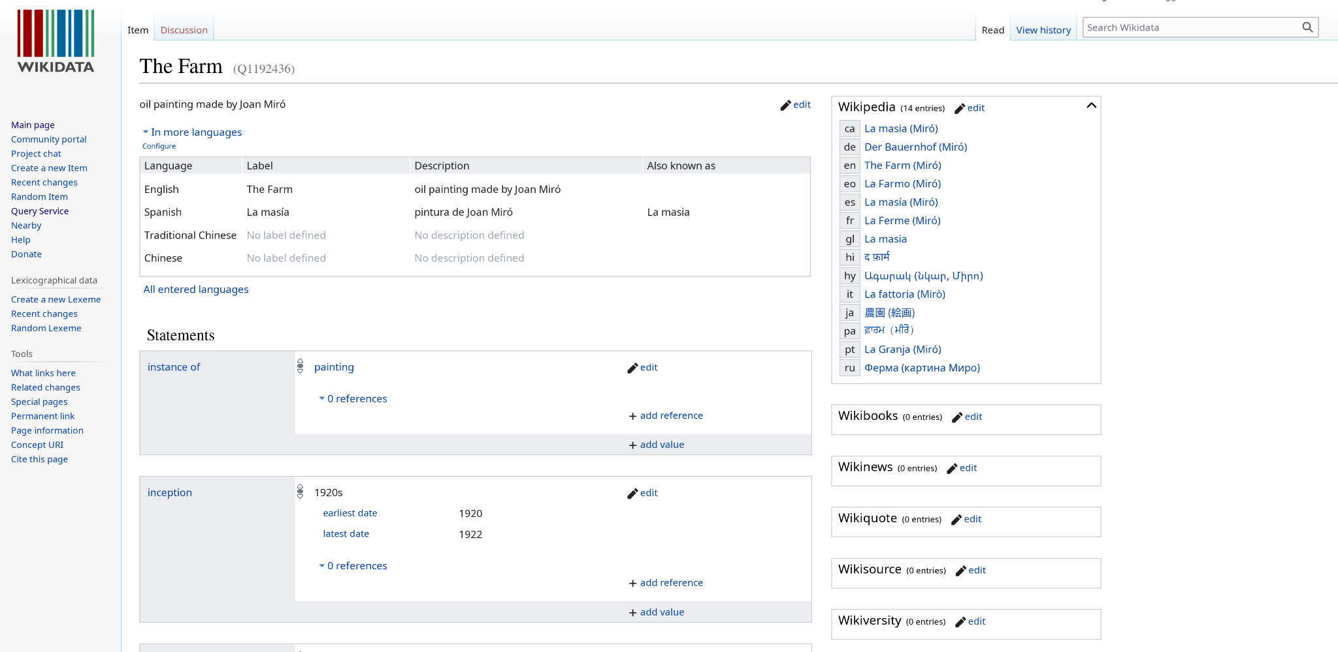
HumanMadeObject “equivalent” / schema.org “sameAs”

Slide 37
VisualItem and HumanMadeObject Unique Properties
Mapped Linked.art VisualItem JSON-LD example | Mapped Linked.art HumanMadeObject JSON-LD example
<script type="application/ld+json"> { "@context": "https://schema.org", "@type": "VisualArtwork", "name": "The Farm", "alternateName": "Appearance of The Farm", "creator": [ { "@type": "Person", "name": "Juan Miro" } ], "dateCreated": "1922", "mainEntity": "Tree", "contentLocation": "Mont-roig del Camp", "url": "https://www.nga.gov/collection/art-object-page.69660.html", "description": "A brilliant amalgamation of an intense, even primitive, realism with the formal vocabulary of cubism." } | <script type="application/ld+json"> { "@context": "https://schema.org", "@type": "VisualArtwork", "name": "The Farm", "alternateName": "Appearance of the Farm", "artForm": "Painting", "creator": [ { "@type": "Person", "name": "Juan Miro" } ], "dateCreated": "1922", "locationCreated": "Mont-roig del Camp, Spain", "sameAs": "https://www.wikidata.org/wiki/Q1192436", "url": "https://www.nga.gov/collection/art-object-page.69660.html", "description": "A brilliant amalgamation of an intense, even primitive, realism with the formal vocabulary of cubism.", "height": "123.8 centimeters", "width": "141.3 centimeters", "artworkSurface": "Canvas", "artMedium": "Oil Paint" }
Unique to
VisualItem
Unique to
HumanMadeObject

Slide 38
VisualItem and HumanMadeObject Redundancy
"created_by": { "type": "Creation", "timespan": { "type": "TimeSpan", "_label": "1921-1922", "begin_of_the_begin": "1921-01-01T00:00:00Z", "end_of_the_end": "1922-12-31T23:59:59Z" }, "carried_out_by": [ { "id": "http://vocab.getty.edu/ulan/500014094", "type": "Person", "_label": "Juan Miro" } ] }, "represents": [ { "id": "http://vocab.getty.edu/tgn/7300934", "type": "Place", "_label": "Mont-roig del Camp" } ] } | "produced_by": { "type": "Production", "timespan": { "type": "TimeSpan", "identified_by": [ { "type": "Name", "classified_as": [ { "id": "http://vocab.getty.edu/aat/300404669", "type": "Type", "_label": "Display Title" } ], "content": "1921-1922" } ], "begin_of_the_begin": "1921-01-01T00:00:00Z", "end_of_the_end": "1922-12-31T23:59:59Z" }, "took_place_at": [ { "id": "http://vocab.getty.edu/tgn/7000457", "type": "Place", "_label": "Mont-roig del Camp, Spain" } ], "carried_out_by": [ { "id": "http://vocab.getty.edu/ulan/500010879", "type": "Person", "_label": "Juan Miro" } ] } }

Slide 39
VisualItem and HumanMadeObject Redundancy
Mapped Linked.art VisualItem JSON-LD example | Mapped Linked.art HumanMadeObject JSON-LD example
<script type="application/ld+json"> { "@context": "https://schema.org", "@type": "VisualArtwork", "name": "The Farm", "alternateName": "Appearance of The Farm", "creator": [ { "@type": "Person", "name": "Juan Miro" } ], "dateCreated": "1922", "mainEntity": "Tree", "contentLocation": "Mont-roig del Camp", "url": "https://www.nga.gov/collection/art-object-page.69660.html", "description": "A brilliant amalgamation of an intense, even primitive, realism with the formal vocabulary of cubism." } | <script type="application/ld+json"> { "@context": "https://schema.org", "@type": "VisualArtwork", "name": "The Farm", "alternateName": "Appearance of the Farm", "artForm": "Painting", "creator": [ { "@type": "Person", "name": "Juan Miro" } ], "dateCreated": "1922", "locationCreated": "Mont-roig del Camp, Spain", "sameAs": "https://www.wikidata.org/wiki/Q1192436", "url": "https://www.nga.gov/collection/art-object-page.69660.html", "description": "A brilliant amalgamation of an intense, even primitive, realism with the formal vocabulary of cubism.", "height": "123.8 centimeters", "width": "141.3 centimeters", "artworkSurface": "Canvas", "artMedium": "Oil Paint" }
Duplicate or Redundant Data

Slide 40
VisualItem & HumanMadeObject Mapped to Combined Schema.org JSON-LD
<script type="application/ld+json"> { "@context": "https://schema.org", "@type": "VisualArtwork", "name": "The Farm", "alternateName": "Appearance of The Farm", "artForm": "Painting", "creator": [ { "@type": "Person", "name": "Juan Miro" } ], "dateCreated": "1922", "mainEntity": "Tree", "contentLocation": "Mont-roig del Camp", "locationCreated": "Mont-roig del Camp, Spain", "sameAs": "https://www.wikidata.org/wiki/Q1192436", "url": "https://www.nga.gov/collection/art-object-page.69660.html", "description": "A brilliant amalgamation of an intense, even primitive, realism with the formal vocabulary of cubism." "height": "123.8 centimeters", "width": "141.3 centimeters", "artworkSurface": "Canvas", "artMedium": "Oil Paint" }

Slide 41
Using with Georgia O’Keeffe data
These differences must be accounted for:
The O’Keeffe model uses the type ManMadeObject instead of HumanMadeObject.
The type-of-types pattern is not used by the O’keeffe model, but this can be ignored.
The “label” property must be changed to “_label to match the Linked Art model.
LinguisticObject and Identifier properties must be changed from “value” to “content”.
Human-readable timespan dates are expressed using the “label” property instead of the identifier (relationship) TimeSpan.

Slide 42
Project Conclusion
Extension of data model to Schema.org is achievable, but complicated. Involves lots of manual matching types and properties.
The result emphasizes a need for a standard of structured data across the web.
We prefer Schema.org’s hierarchical design and ease of use, although we lose some expressiveness from Linked Art.

Slide 43
Comments on relational model
Semantic web uses linked types and properties, foregoing foreign and primary keys.
The Internet of Things is too massive to create a relational model that encompasses everything.
Elements of Entity Relational model can help us understand and describe how to structure data.

Slide 44
Questions?

